Slide 1
Let’s explore the GUI!
Before saying bye-bye to your mouse...

Slide 2
WhAt Is A GuI????

Slide 3
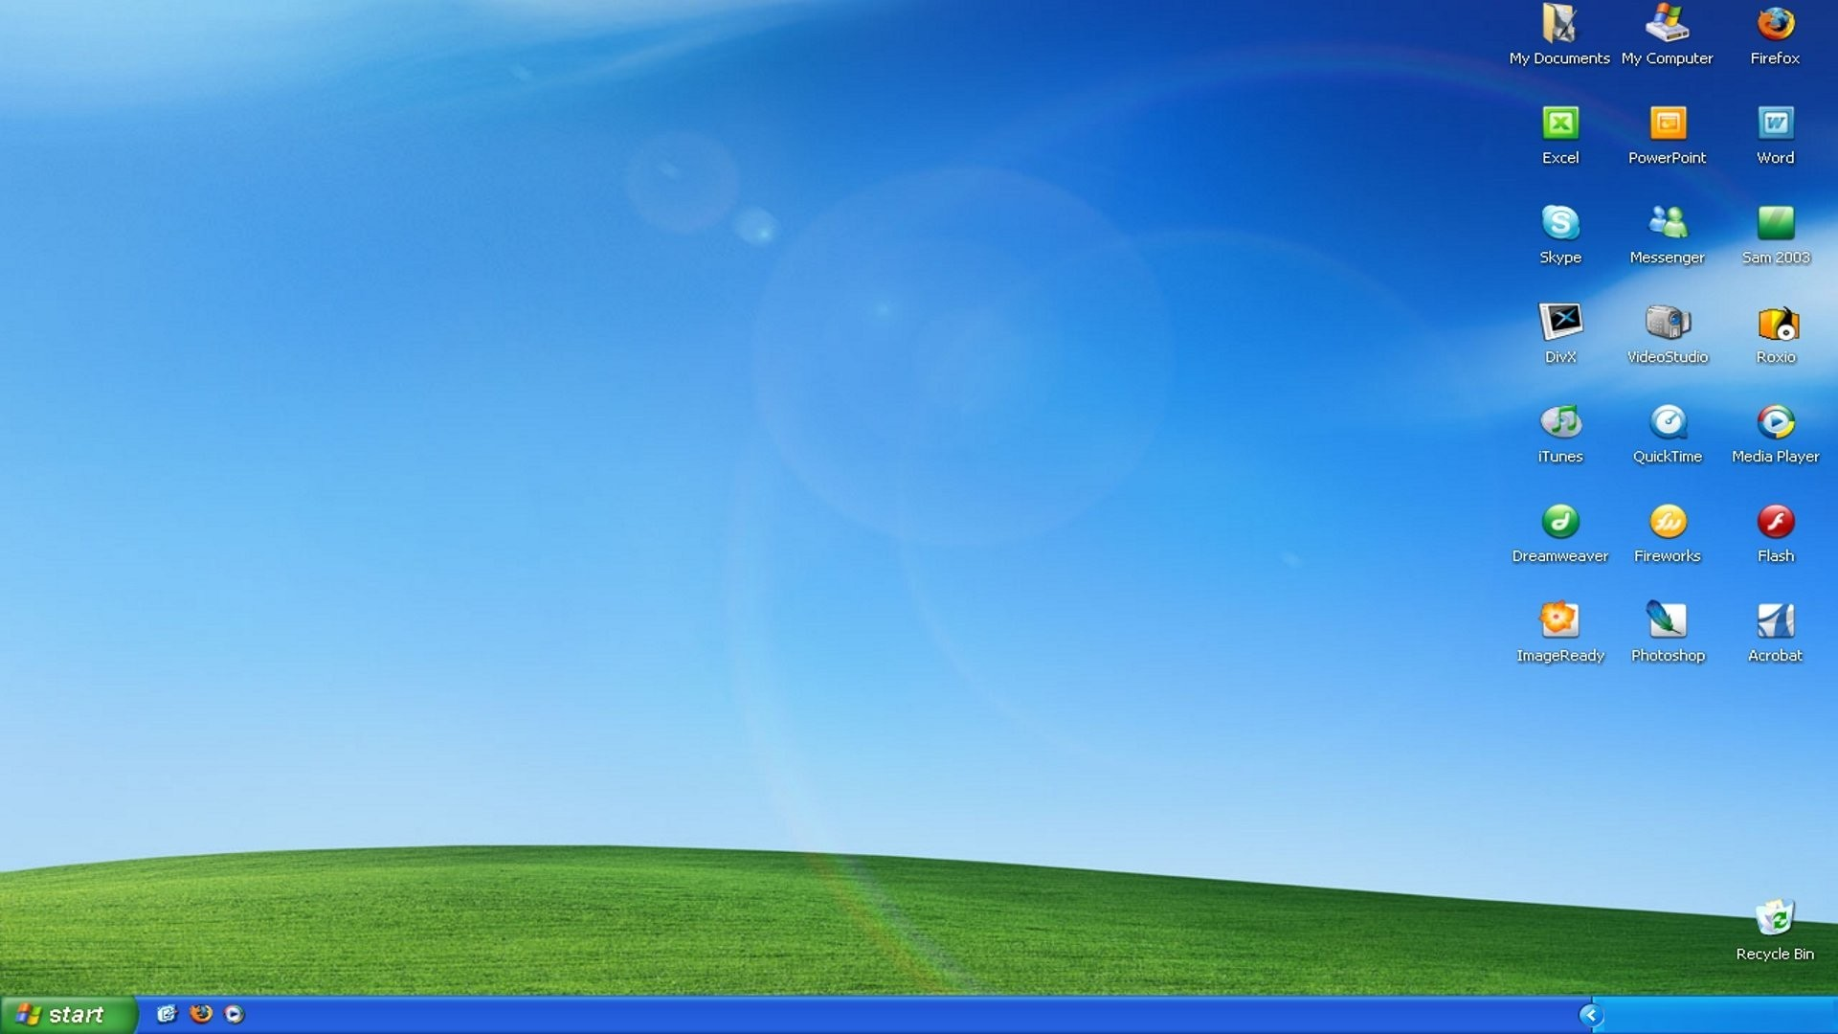
Graphical User Interface
This is what you mostly use in Windwos
Makes it easy for the average user to move around the system
Haha mouse goes brrrrrrrrrrrrrrrrrrrrrrrrrr

Slide 4
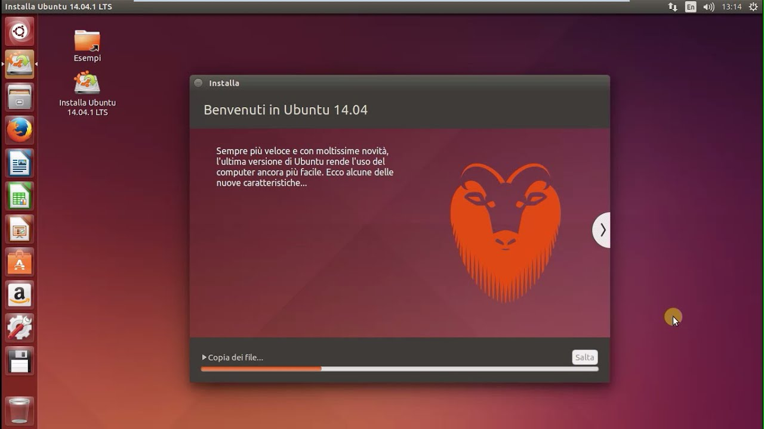

Slide 5


Applications/Programs/Packages
Computer runs these to do specific functions
You will sometimes prompt them to open and run
Other times they run by themselves
They are run through processes (ongoing actions in the computer)
Many are preinstalled into the OS, other are not
They are called 3rd party software

Slide 6
Common GUI Apps
Not the ones that seniors are supposed to be filling out...

Slide 7
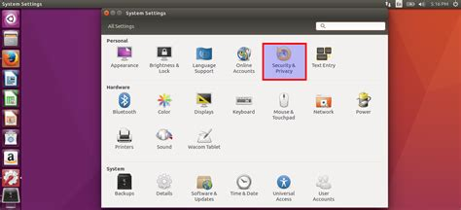
System Settings
Edits settings to customize the computer to your liking
Power
Display
Color/Appearance
Date and Time
Network
Bluetooth
User Accounts (we will talk abt that soon)
Updates (we will cover that soon too)

Slide 8

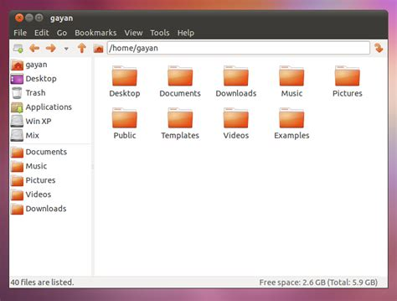
File Manager (Nautilus)
You can see and change your files here
Opening file will lead you to opening them in other applications

Slide 9
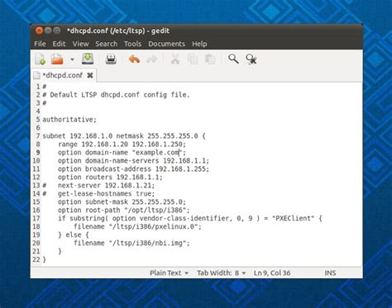
Gedit
Text editor
Allows you to type stuff in files
Shortcuts:
You guys know how to copy and past right?
Ctrl+S to save
You will be using text editors a lot in the upcoming weeks

Slide 10

Web Browser (Firefox)
Where you access the Internet
You can see and visit websites as well as interact with them
It is also customizable through their settings
We will talk abt this later

Slide 11
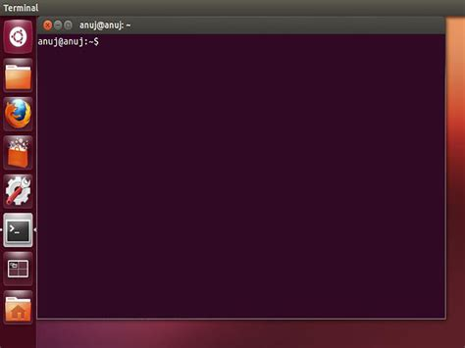
T h e T e r m i n a l
The portal to a mysterious world…
YOU WILL LIVE IN THIS FOR THE REST OF YOUR LINUX CAREER
Source of the user’s power lies here
Welcome to the Keyboard Realm

